Slide 1
Sales Performance Dashboard
Objective: Create an interactive dashboard that enables business stakeholders to monitor sales performance, profit, and trends through visual analytics.
by Sumaiya Begum

Slide 2
Dataset
Name: E-Commerce Sales & Profit Analysis Dataset
Source: Kaggle
File Format: CSV
Records: 3,501
Fields: Order Date, Product Name, Category, Region, Sales, Profit

Slide 3

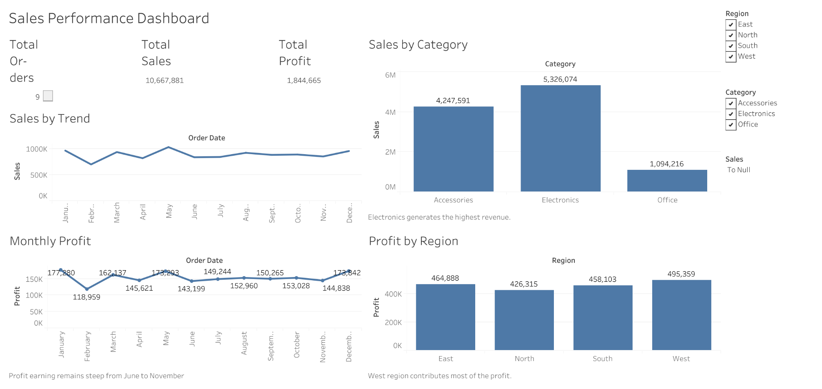
1. Dashboard

Slide 4

The dashboard provides an interactive overview of sales performance using KPIs, charts, and filters.

Slide 5
Key Insights
By the end of the analysis, here’s the data we can visualize:
Electronics generated the highest sales.
The West region recorded the highest profit.
Sales increased at the end of the year.
Profit Earning remained steep from June to November

Slide 6


Conclusion
The dashboard enables business stakeholders to monitor sales performance, compare regional and category performance, identify trends, and make data-driven decisions through interactive visualizations.
Tool
Tableau Public

